Slide 1
ALU – Appendix B

Slide 2
ALU
Arithmetic/Logic Unit
Heart of computation in a Computer
Performs
AND
OR
Addition
Subtraction
SLT (Set less than)
Implemented as a logic circuit

Slide 3
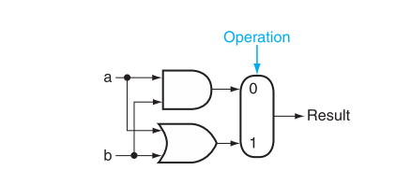
One Logic unit
Name this
component

Slide 4
1-bit adder
What do we need?
Input: Two bits to add
Output: Result and a Carry

Slide 5
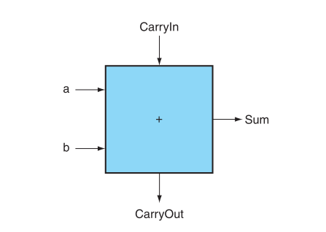
1-bit adder (conceptual)
Called a “Full Adder” or “3,2 Adder” for 3 in, 2 out
When there are only 2 inputs, it’s a “Half Adder” or “2,2”

Slide 6
1-bit adder
Where to start?
First we define the logic table
Then we reduce if possible

Slide 7
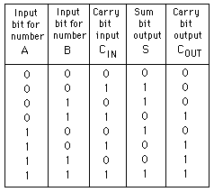
1-bit adder Logic Table
S= A XOR (B XOR C)
C_{out} = BC_{in} + AC_{in} + AB

Slide 8
process
Build gates to figure out carryout
Build gates to figure out result
Glue together

Slide 9
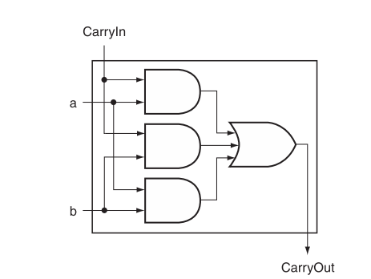
CarryOut

Slide 10
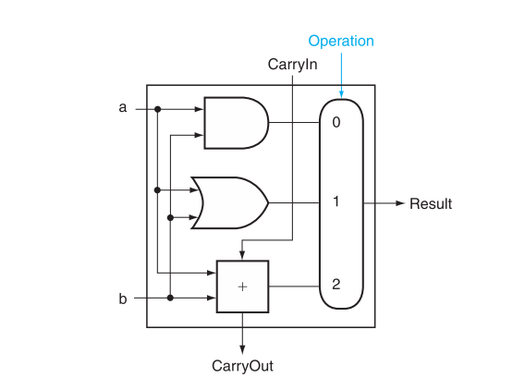
1 bit basic ALU
1-bit ALU that performs AND, OR, addition

Slide 11
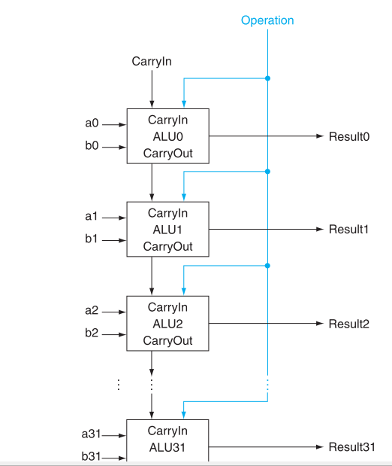
32-bit basic ALU

Slide 12
How to handle subtraction?
What is subtraction anyway?
Adds the negative of the second operand
Need to invert bits of second operand and add 1
How can we use carry in for this purpose?
Goal: minimize hardware
Reuse what you have as much as possible

Slide 13
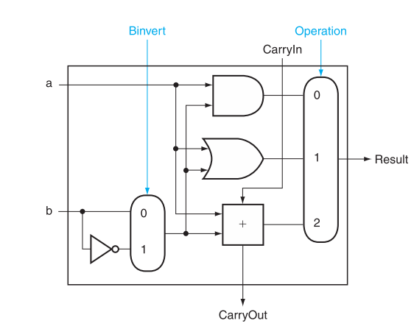
1-bit ALU with subtraction
Think about CarryIn for bit 0 – what should it be?

Slide 14
NOR?
Easy now that we have the idea

Slide 15
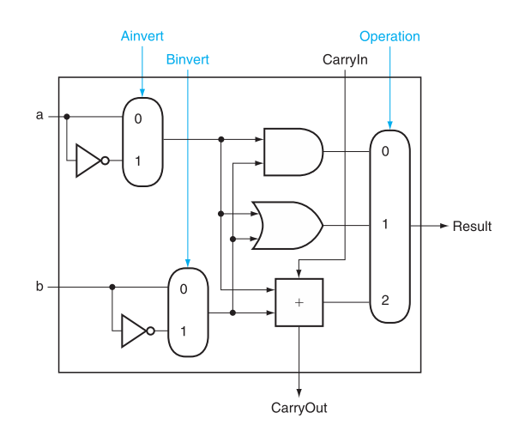
AND, OR, ADD, SUB, NOR
By selecting A_{invert}
And B_{invert} and
Operation 0 we get
A NOR B

Slide 16
SLT – Set Less Than
If (a<b), set the least significant bit to 1, otherwise make it 0
Comparisons are done by subtraction:
LSB is 1 if a-b is negative, 0 otherwise
Where else do we see 1 for neg? 0 for positive?

Slide 17
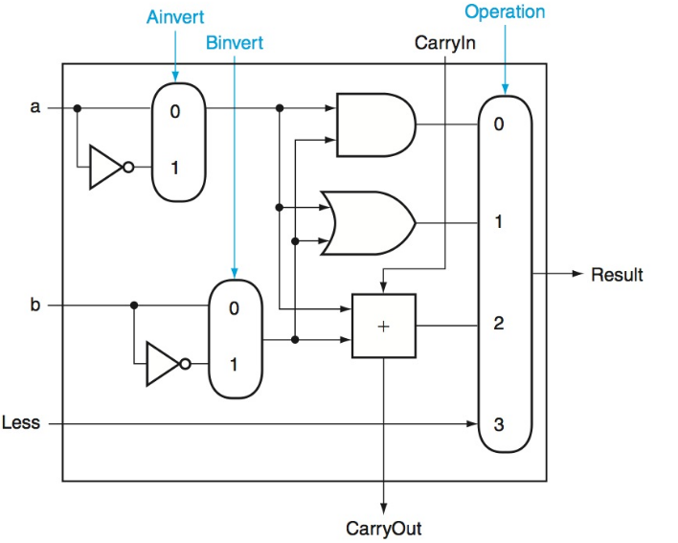
ALU with SLT

Slide 18
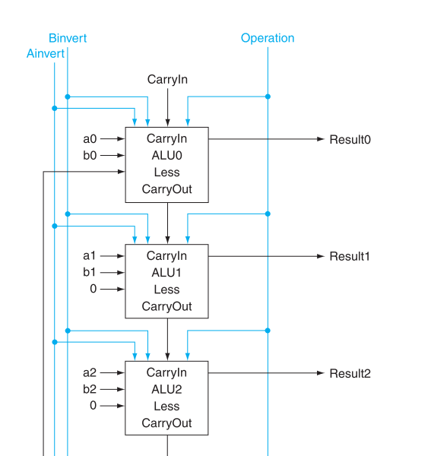
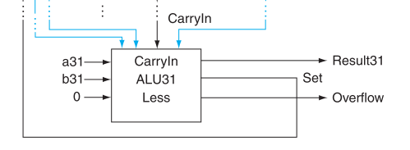

Slide 19
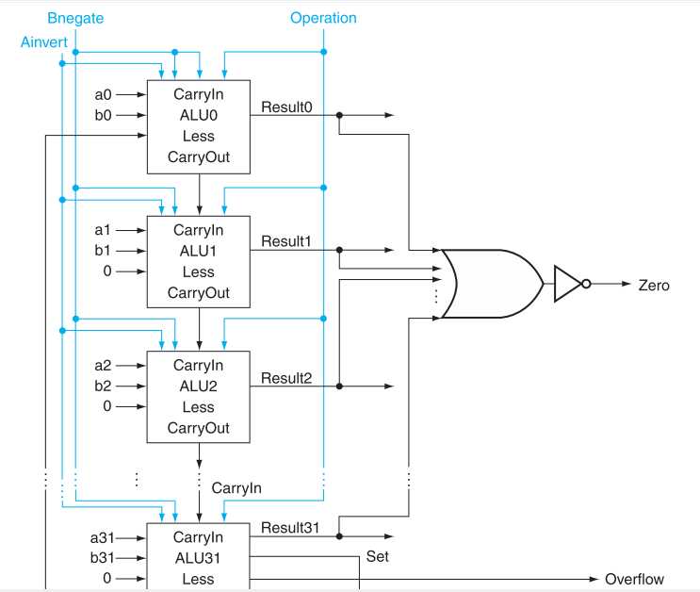
Final ALU – include 0 detector

Slide 20
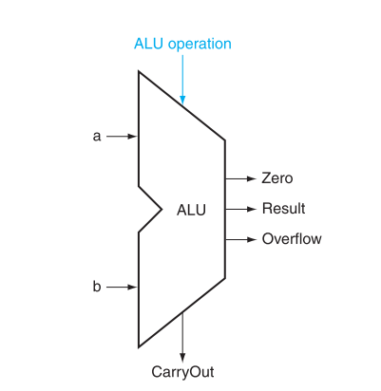
ALU Symbol

